Slide 1




FUNGUY team’s project for NASA Space App Challenge
WITH SUPPORT FROM

Slide 2

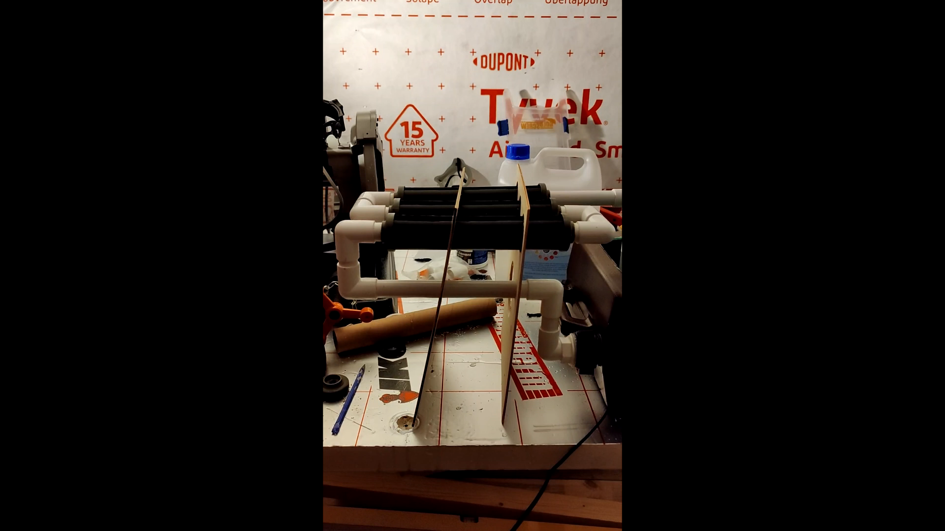
GUMS: Growth Unit for Mushrooms in Space consists of:
Electromagnetically treated mixer for nutrient mixing and solution sanitation
Hydroponic porous ceramic tubes for nutrient delivery and recycling
Wireless environmental monitoring system

Slide 3
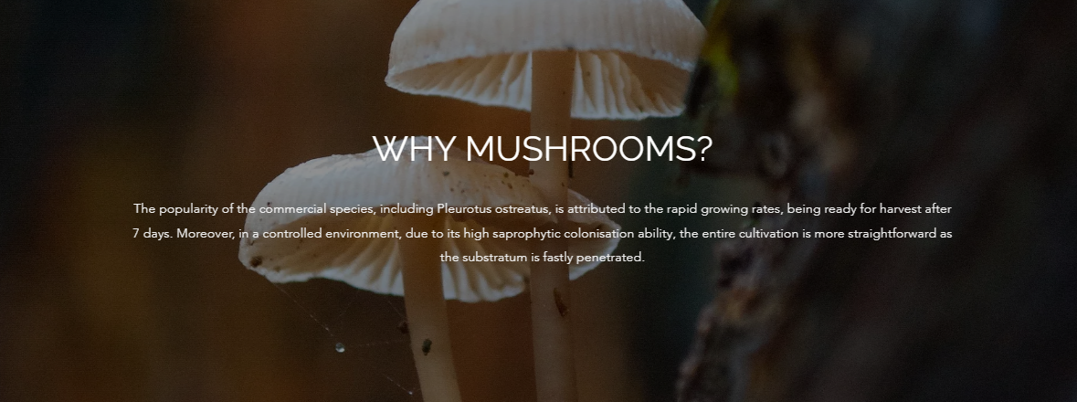
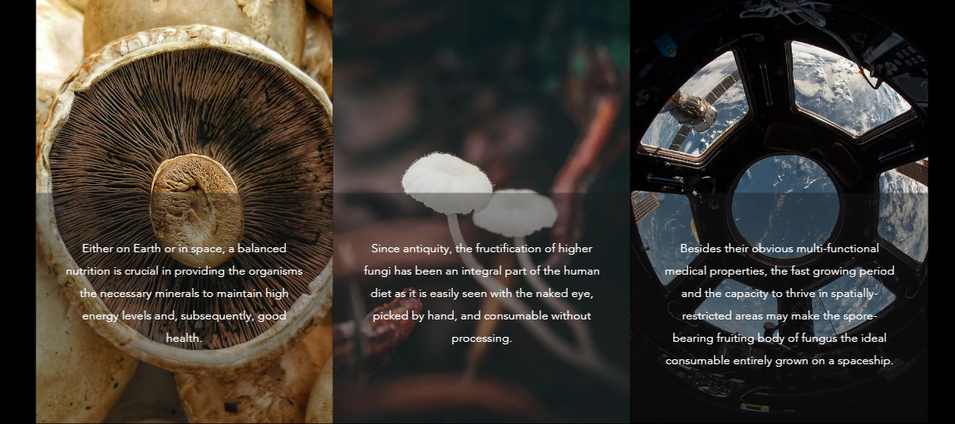

Slide 4
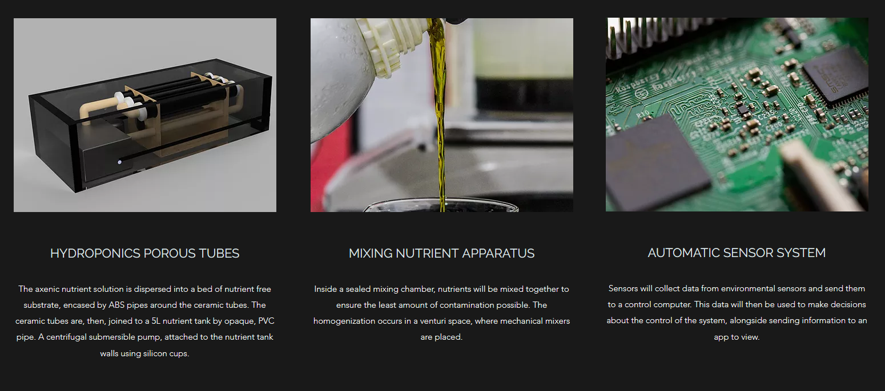
OUR DESIGN

